Slide 1
Data Visualization
Dec 2017
Notes:
http://cacm.acm.org/magazines/2010/6/92482-a-tour-through-the-visualization-zoo/fulltext
https://www.cs.ubc.ca/~tmm/vadbook/

Slide 2
Contents
What is data visualization?
Why bother?
Design critiques
Importance of design
Visual Variables to Charts to Networks to High Dimensional Data

Slide 3
Visualization
noun vi·su·al·i·za·tion \ˌvi-zhə-wə-lə-ˈzā-shən, ˌvi-zhə-lə-, ˌvizh-wə-lə-\
formation of mental visual images
the act or process of interpreting in visual terms or of putting into visible form
the process of making an internal organ or part visible by the introduction (as by swallowing) of a radiopaque substance followed by radiography
Source: Merriam-Webster dictionary

Slide 4
(Data) Visualization
To convey information through graphical representations of data
Notes:
Next – but why visualize? What is the point of visualization? Ask the class for ideas and write on board.
This diagram is called a Circos plot, originally designed to analyze the relationships between gene markers and the strengths of relations, groupings etc. (see paper “Circos: An information aesthetic for comparative genomics”, http://genome.cshlp.org/content/early/2009/06/15/gr.092759.109.abstract

Slide 5
Goals of visualization
Record information
Analyze data to support decision making
Communicate information to others
Notes:
Record – photographs, blueprints, seismographs
Analyze – Exploring data visually to develop and assess hypotheses; pattern finding and looking for errors/unusual features
Communicate – Visual explanations to share and explain things; Powerpoints to the boss; infographics

Slide 6
Notes:
Record
Darwin’s sketches. Charles Darwin on his voyages around the world looking for evidence of evolution drew pictures of different species in order to keep a record of the things he saw – photography wasn’t advanced enough at the time, and simply using words – as he did in his journals – he knew would not necessarily be sufficient.

Slide 7
Notes:
Tutankhamen's Tomb
Maps are extremely powerful representations of the real world. Again, this was interpreted from somebody’s head – somebody translated what they saw into some representation in the minds and then recorded it on paper.

Slide 8
Notes:
Analyze
Understanding planetary movements – graphing the movements of planets across the night sky (unknown source, apparently 950AD)
Supposedly the earliest known attempt to show changing values graphically (positions of the sun, moon, and planets throughout the year)

Slide 9
Notes:
Analyze
Understanding weather patterns

Slide 10
Notes:
Analyze. Adding more information to maps than just wind directions, also measuring things we can’t necessarily see very easily. Adding colours to wind data as well.
Understanding weather patters still uses visualization to inform researchers (ECMWF)

Slide 11
Notes:
Communicate
Informing people – you want other people need to know what you know – maps are very useful
Tube map, 1908
Demonstrates overlaying information

Slide 12
Notes:
Communicate
Visualizations can be more abstract – Tube maps evolved to look more like circuits

Slide 13
Notes:
Communicate
Harry Beck, 1933, technical draughtsman for LU

Slide 14
Notes:
Modern day tube map – styling is mimic’d across many other metro networks.

Slide 15
The Best Stats You Have Ever Seen
https://www.youtube.com/watch?v=usdJgEwMinM
Notes:
So far, we’ve seen some non-interactive stuff based on maps.
What else? “The Best Stats You Have Ever Seen”. Hans Rosling – professor of international health at the Karolinska Institute in Sweden.
TED talk 2006; from 4 minutes
Using animations in visualizations can be very powerful, however if not obvious, it requires interaction with the visualization. We can then tell stories with visuals (whether animated or not).
Who interacts? The audience can. A storyteller (the presenter) can, like in Hans Rosling’s TED talk.

Slide 16
Storytelling
https://vimeo.com/9225227
Notes:
Codeswarm video from Twitter
Storytelling with data is extremely important and you can use a set of visuals or create a movie to tell a story with your data. This might make it more compelling and also gives a way to better convey information as you’re guiding the viewer’s attention through the data.
Here, we can see visually the interaction between developers and different files that were written for Twitter over a number of years. It’s not really scientific, but you can see how the development team started off as just a couple of guys, eventually growing into a big development team.

Slide 17
Why data visualization?
Big data
Limits to cognition/understanding
Visual queries are easier to understand (even with summarized statistics, abstract visual cues are fast)
Notes:
When dealing with big data, we might find we reach limits to understanding the outputs of our data analyses.
What have we been doing in all our processing? Basically looking for patterns, but also summarizing data into something we can understand.
Viz can help!

Slide 18

Yahoo!’s ‘user DNA’
Registration
Behaviour
Checks Yahoo! email daily on phone
Campaign
Lives in London
Recruitment consultant
Searched for “British Bake Off Cupcakes”
Unknown
Spends 20 hours pw on Web
Clicked on ad for Sony 42” TV
Purchased Prometheus from Amazon
Searches made from London, UK last week
Searched for “Michael Gove”
Female, Age 28
Example borrowed/modified from Usama Fayyad (CDO, Barclays)

Slide 19


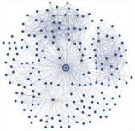
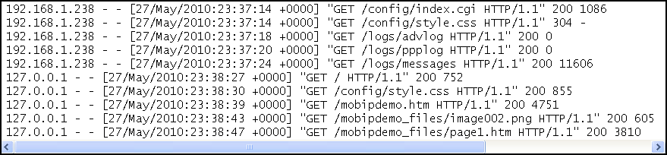




Registration
Behaviour
Campaign
Unknown
Checks Yahoo! email daily on phone
Searches made from London, UK last week
Recruitment consultant
Searched for “British Bake Off Cupcakes”
Lives in London
Searched for “Michael Gove”
Female, Age 28
Purchased Prometheus from Amazon
Clicked on ad for Sony 42” TV
Spends 20 hours pw on Web

Slide 20
Limits to cognition
Which gender or income level group shows different effects of age on cholesterol levels?
Notes:
While all the information is in this table, it’s not particularly easy to extract any relationships or patterns out of it. It’s not overloaded or anything either.

Slide 21
Limits to cognition
Notes:
Once in visual form, we can much easier spot relationships between these variables.

Slide 22
Critique
Notes:
What’s good about this visualization?
What’s bad/problems about this visualization?
How might you improve this visualization?

Slide 23
Critique
Notes:
Good / bad

Slide 24
Critique
Notes:
Good / bad

Slide 25
Critique
Notes:
Good / bad

Slide 26
Critique
Notes:
Good / bad

Slide 27
Critique
Notes:
Good / bad

Slide 28
Critique
Notes:
Good / bad

Slide 29
Importance of Design
Notes:
What we try to get out of this exercise is that design is vitally important in conveying our data. We need to consider many things including…
Shapes, lines, colours, texture, size, space, positions…
This may sound all very vague but there’s a lot of academic and technical work on visualization, such as…

Slide 30
Edward Tufte
Notes:
Edward Tufte, a political scientist/statistician/computer scientist at Yale, wrote a number of seminal works on visual design and is seen as having defined the main ‘good’ design principles, especially for data visualization.
This book is 1986, 30 years ago.
“The grandfather of dataviz”

Slide 31
Design Principles
Graphical integrity
Always tell the truth about the data
Use clear, detailed labels to defeat distortion and ambiguity
Show data variation, not design variation
Design aesthetics
Be clear and precise
Maximize data-ink ratio (i.e. reduce redundant display of information)
Avoid chartjunk
Maximize data density
Notes:
Main principles he purports are:

Slide 32
Notes:
What’s wrong with this picture?
Graphical integrity: Sometimes graphs can be incredible misleading (or just plain stupid)

Slide 33
Graphical integrity
Notes:
Always make sure what you’re depicting accurately represents the data

Slide 34
Notes:
What’s wrong with this picture?
Graphical integrity (distortion and ambiguity) - Sometimes accuracy isn’t always the issue, but how data is presented may be accurate and still misleading

Slide 35
Graphical integrity
Notes:
A couple of tips:
ALWAYS start your bars at zero
No chartjunk
Use meaningful labels

Slide 36
Scale distortions
Notes:
Scale distortions can also be misleading (putting different scales on the same chart)
Left – two scales on y axis
Right – using same scale

Slide 37
Notes:
Again, you can have an accurate chart if you are selective about the data….
Here – shows last 15 years of data only

Slide 38
Notes:
If all the data is available to show a real story, show all the data (don’t mislead)

Slide 39
Notes:
Using scales for misrepresenting/misleading conclusions about data.
Here, somebody is trying to show that the ‘Stand Your Ground’ law (a law that enables you to legally use deadly force for self protection) caused a decrease in murders committed using firearms.
This allegedly was published by Reuters, and the graphic artist who created this graph claims they were using artistic license to make the graph look like blood dripping down a wall.

Slide 40
Notes:
Of course it should be this way around, clearly showing a big jump in gun deaths after the law was enacted around 2005.

Slide 41
Avoid chartjunk
Notes:
Avoiding chartjunk is basically the idea of removing any unnecessary visual items that don’t convey any more to the viewer than is necessary.
So for example, what could we remove from here?

Slide 42
Avoid chartjunk
Notes:
Is the colour necessary?

Slide 43
Avoid chartjunk
Notes:
What about the border on the top and right that are not part of the axes?

Slide 44
Avoid chartjunk
Notes:
What about the axes themselves?

Slide 45
Avoid chartjunk

Slide 46
Avoid chartjunk

Slide 47
Examples of bad charts
Notes:
In general 3D charts are ugly and are not necessary.

Slide 48
Visual Variables
Basic model for stuff we measure (data):
From Science paper “On The Theory of Scales and Measurements”, basically:
Nominal scale – categorization
Ordinal scale – continuous, comparable
Interval scale – kind of like ordinal but no true zero
Ratios – can measure ratios and proportions
Also, entities, relationships and attributes
=> Jacques Bertin’s Visual Variables
Notes:
Science paper written in 1946!!

Slide 49
Notes:
Visual variables – each has their own appropriate uses, but we won’t get into these.

Slide 50
Notes:
Network visualizations can be pretty. But are they useful?
http://internet-map.net/

Slide 51
http://neo4j.com/graphgist/b9833a175976a959d7d6
Notes:
Network visualization and exploring using Neo4j
GBV family tree; neo4j GraphGist Challenge winner, winter 2015

Slide 52
Charts
Many many different kind of charts…
Notes:
Histograms, pie charts, box plots, scatterplots, bar charts, run charts (time series), dendrograms (comparative relationships), radial diagrams (multiple dimensions)
Depending on your needs, different visual variables are used

Slide 54
High dimensional data
Heatmaps
Connected charts
Animations

Slide 55
Notes:
High dimensionality
Heatmaps (and maps in general) can be extremely illustrative. In this example, we have

Slide 56
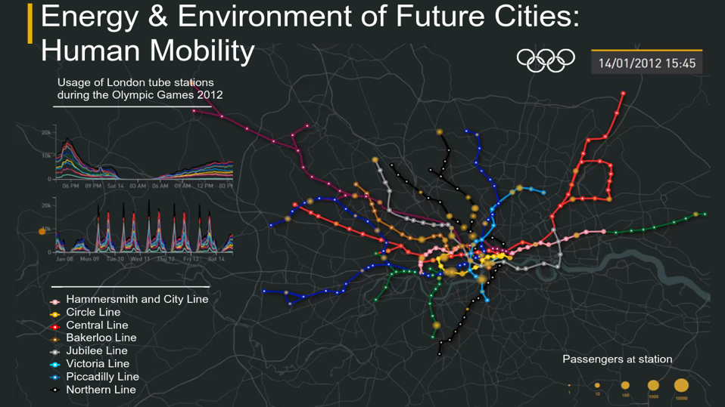
NYC version https://www.youtube.com/watch?v=g6EaMQDHu7Q
Notes:
Show NYC version
https://www.youtube.com/watch?v=g6EaMQDHu7Q

Slide 57
Visualization Systems
Much visualization tooling is currently centered around how to present information on standard displays
Web
Desktop/laptop
Tablets/mobile
What about on big devices/systems?

Slide 58
Notes:
Immersive collaborative and virtual environments (e.g. CAVE from EVL) a lot of money at the time ($1M, around 2000)
This particular one was installed in Reading university

Slide 59
Notes:
Next generation - CAVE2 from EVL ($2M, 2015)

Slide 60
Notes:
Touch tables such as MS Surface “coffeetable” (although this one was developed by a PhD student before surface came out), now commonplace on tablets

Slide 61
Notes:
Imperial Data Observatory (Nov 15)
Backed by a distributed rendering system (32 high-spec graphics PC boxes) mounted on back of the system, bespoke software, 64 4K HD screens
Built with ~£250K

Slide 63
Notes:
Oculus rift/Google glasses etc.
~£500

Slide 64
How does this fit in with the rest of CLO?
Visualization could plug into different stages of your processing pipeline in data science/experimental exercises.
Important for how to turn your big data analyses into summarized and presentable artefacts (typically for human consumption)
Externalizing data representation into visual artefacts to use our visual cognition compliments our mind’s cognitive abilities to extract meaning from data.
Notes:
This lecture is only really intended to give a taste and appreciation of data visualization, and hopefully you can see how it links in with the rest

Slide 65
Visualization tools and frameworks
Code/scripting frameworks
D3 (JS, very very widely used), bokeh, matlibplot (Python), R, and loads loads more….
Tools
Tableau, Circos, MATLAB, Octave and more…
…lab time!
Notes:
Tableau is apparently the no. 1 BI tool
Circos – using circular graphs for everything (originally from genomics)
Statistical frameworks and packages can usually plot graphs and many visualizations

